Slide 1
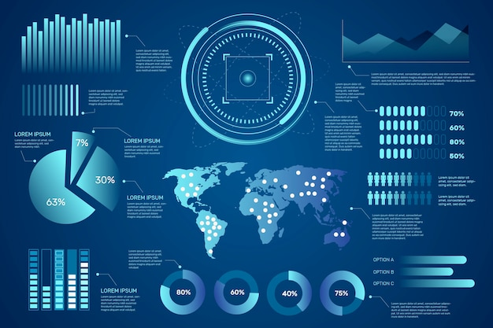
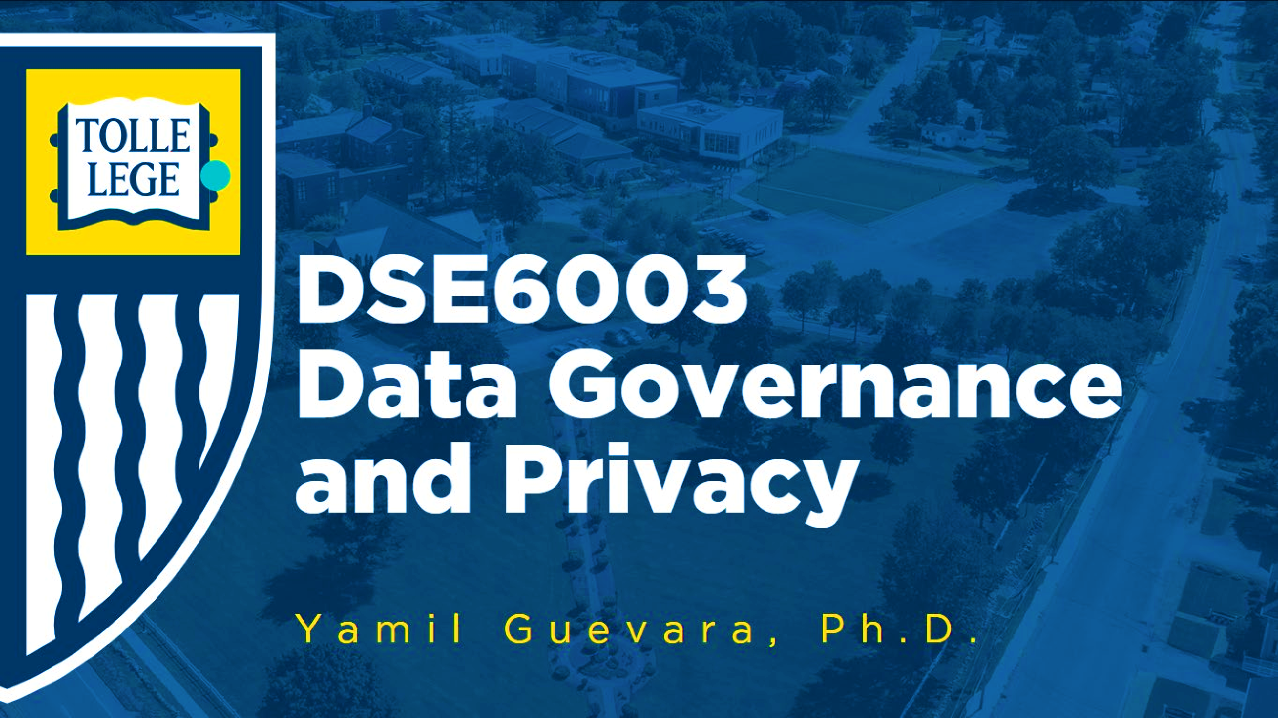
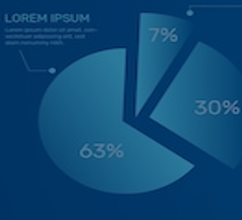
DSA5400
Visual Data Exploration
Module 3: Deeper Dive into Plotting
Michael Dupin, Ph.D.

Slide 2
Course Roadmap & Assignments
Week 1 | Week 2 | Week 3 | Week 4 | Week 5 | Week 6 | Week 7 | Week 8
Course learning objectives Data, information, and knowledge Intro to data visualization | Data as a competitive advantage CRISP framework Human perception and cognition | Data types Intro to ML Grammar of graphics | EDA process ggplot2 (Grammar of graphics continued) | Diagnosis and treatments Special cases: time, space, and clusters | Segmentation R Shiny | Segmentation and profiling Tableau and other dashboards | Course wrap-up Tableau
Introduction | Position Paper #1 | Position Paper #2 | Data Due Diligence Project |  | Segmentation and Profiling Project
Quiz 01 | Quiz 02 | Quiz 03 | Quiz 04 | Quiz 05 | Quiz 06 | Quiz 07 | Quiz 08

Slide 3
Data Due Diligence Project Overview
Some Pointers

Slide 4

Data Due Diligence Project – Objective and Data
Due Diligence Project
Project Objective
Demonstrate that you not only grasp the meaning of the various analytical data review and related concepts, but are also able to apply those concepts to real data to address business problems
Conduct a comprehensive assessment of the customer base with a focus on data due diligence
Grading will not be on the code (Tableau or R or anything else) but on what you’ll have looked for, created, found, comments.
Data
Curated customer dataset containing 5,000 random customers from a telecommunications company
60 columns to explore
Data Set Name | CUSTOMER_DATASET_FILE | Observations | 5000
Member Type | DATA | Columns | 60

Slide 5

Data Due Diligence Project – Requirements
Requirement Overview
Starting with the original dataset (which, possibly, contains various deficiencies and misses potential metrics, such as ‘category sales’), you will carry out all necessary data due diligence and feature engineering steps, ultimately creating an updated dataset containing all changes and/or additions you made. These will be student driven tasks.
A concise step-by-step delineation of specific data review and data feature engineering steps taken. Students will also produce a brief (1-2 pages) summary of all data due diligence and feature engineering changes, including a brief (1-2 sentences) explanation rationalizing each action.
1
2
1
3
6
4
5

Slide 6
Summary of Deliverables
(PDF’ed) Word document
Provide categories for all variables (meaning, objective, type... all are possible)
Create at least 10 features/columns and state why you created them (at least 10). These can be cleaned, derived, or normalized columns, among other treatments.
Provide a several examples of qualitative or graphical analysis on features
Single variable plots (chosen by correct type of data - categorical, ordinal, real-values)
Perform at least 5 two-column analyses (scatterplots, regression fits)
A short interpretation of the results
Curated Excel file for the downstream analysis
The original columns
New columns for new features
The tab results of any statistical analysis you do in a tab named “analysis”

Slide 7
Data Due Diligence Project – More About Customer Data
Customer Profile – Who are They?
Customer Relationship and Value
What are their relationship with the company?
What is their value?
Variables
CustomerID
Region
TownSize
Gender
Age
EducationYears
JobCategory
UnionMember
EmploymentLength
Retired
HHIncome
DebtToIncomeRatio
CreditDebt
OtherDebt
LoanDefault
Variables
MaritalStatus
HouseholdSize
NumberPets
NumberCats
NumberDogs
NumberBirds
HomeOwner
CarsOwned
CarOwnership
CarBrand
CarValue
CommuteTime
PoliticalPartyMem
Votes
CreditCard
CardTenure
CardItemsMonthly
CardSpendMonth
ActiveLifestyle
Variables
PhoneCoTenure
VoiceLastMonth
VoiceOverTenure
EquipmentRental
EquipmentLastMonth
EquipmentOverTenure
CallingCard
WirelessData
DataLastMonth
DataOverTenure
Multiline
VM
Pager
Internet
Variables
CallerID
CallWait
CallForward
ThreeWayCalling
EBilling
TVWatchingHours
OwnsPC
OwnsMobileDevice
OwnsGameSystem
OwnsFax
NewsSubscriber

Slide 8

Due Diligence and Segmentation Projects
Data Due Diligence Steps Segmentation & Profiling Steps
Background / Overview
Describe your goals
Business questions addressed
What is the context of the data
Background review
Review
Examine
Overview adapted from Due Diligence project
Review
What is the relevant literature?
Description of local / global statistics
Some research considerations
Data wrangling
Clustering (k-means) and methodological discussions
Profiling
Describe the clusters you identified
Conclusions and recommendations
Examine
Thinking about the data
What are you seeing in the data
Describe
Pulling out the facts
Interesting or surprising results (positive result or lack of positive result)
11

Slide 9
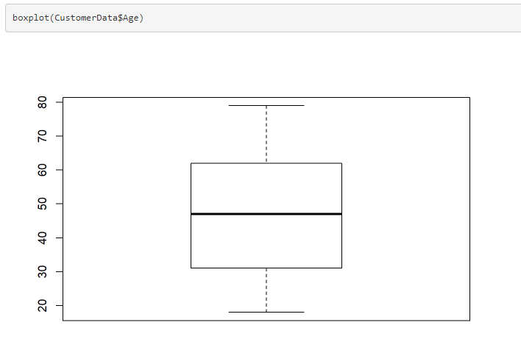
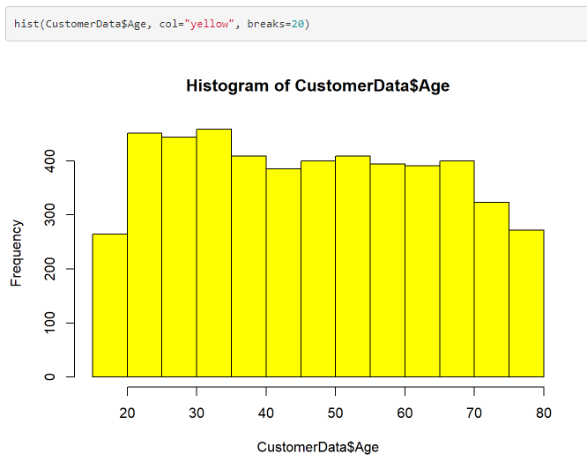
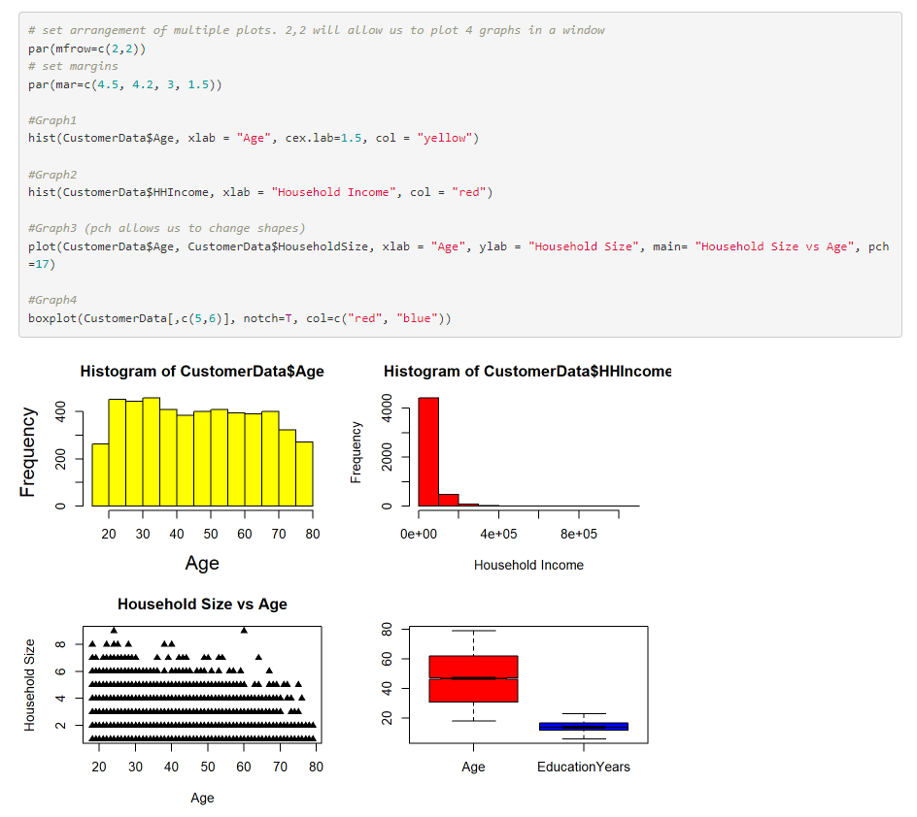
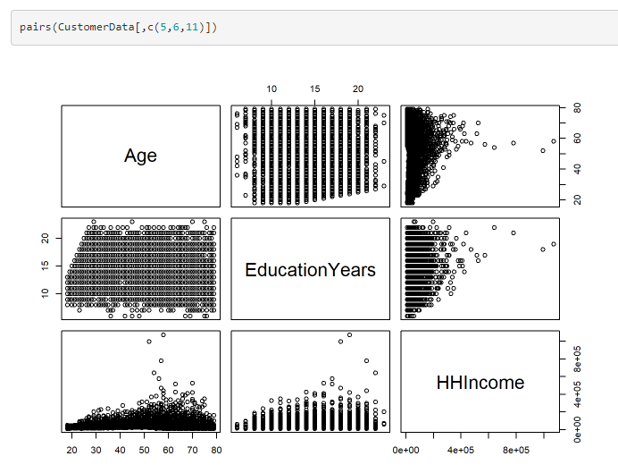
Examples of Visualizations

Slide 10
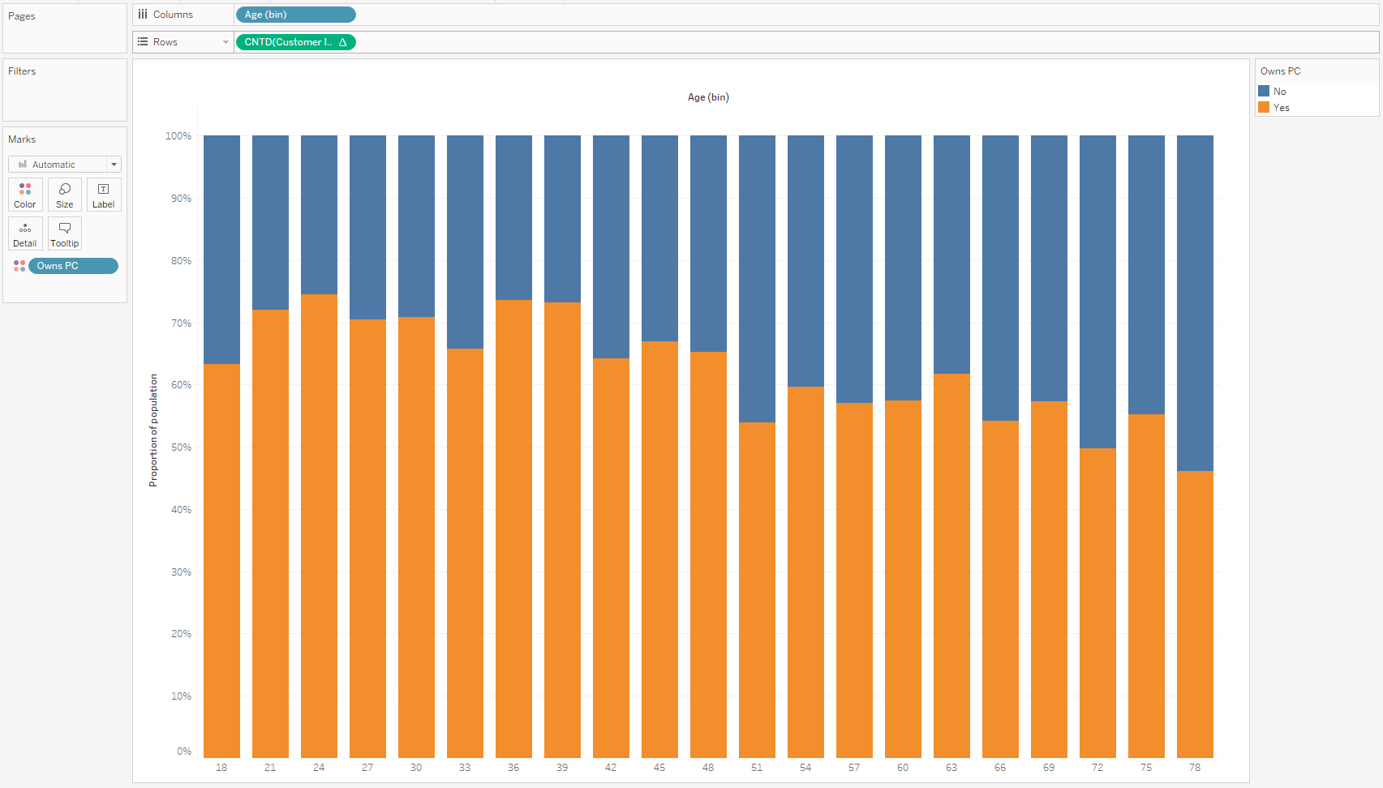
Example: Is there an age component to owning a PC?
CustomerID | Age | OwnsPC
3964-QJWTRG-NPN | 20 | No
0648-AIPJSP-UVM | 22 | Yes
5195-TLUDJE-HVO | 67 | No
4459-VLPQUH-3OL | 23 | Yes
8158-SMTQFB-CNO | 26 | Yes
9662-FUSYIM-1IV | 64 | No
7432-QKQFJJ-K72 | 52 | Yes
8959-RZWRHU-ST8 | 44 | No
9124-DZALHM-S6I | 66 | No
3512-MUWBGY-52X | 47 | No
5621-QSZPSF-NF2 | 59 | Yes
8241-PWPONH-62O | 33 | No
8795-FYOXCT-P09 | 44 | Yes
1705-NMIQNO-IC4 | 58 | Yes
9205-PAZEXY-90Q | 72 | Yes
4225-PZZDIY-IBH | 66 | Yes
0758-EQEGIQ-3OF | 57 | Yes
0649-TBFJFL-QU4 | 63 | No
2228-KOLOPU-FY3 | 28 | No
3853-NVDCOJ-TIN | 78 | Yes
0765-UXAFYM-PDR | 61 | Yes
9937-SFPLRK-H9Y | 70 | Yes
0712-WQXYVV-HUP | 61 | Yes
6441-FJUWZQ-7G8 | 37 | Yes
7634-AVNEXZ-7AG | 39 | Yes
2041-PNMGHX-TXJ | 73 | Yes
4626-BQZAUJ-V9K | 26 | Yes
2969-ODPCDX-5DC | 24 | No
4974-FUBHDF-Z7L | 77 | No
2525-OSULNV-0KS | 36 | Yes
4973-FHPBZQ-AAA | 55 | Yes
Logistic Regression
…
Assess
…
Explain
11

Slide 11
Exploratory Data Analysis (EDA)
Deep Dive

Slide 12


Exploratory Data Analysis Objectives
EDA Workflow
Exploratory data analysis (EDA) and data due diligence are critical components in transforming data into actionable insights and knowledge
The objectives of the exploration stage of data are…
Acquire basic familiarity with the data
Identify continuous vs. categorical variables – Describe
Determine frequencies; Outliers; Data Visualization - Describe
Label variables and data values for interpretation – Describe
Document the extent of missing/bad data and diagnose the data problems - Assess
Explore simple bivariate relationships in the data – Assess
Explore multivariate relationships – Assess
Describe
Assess
Explain
1
2
1
3
6
Exploratory Data Analysis (EDA)
4
5

Slide 13
Exploratory Data Analysis (EDA) Overview
As a First step in a quantitative project :
Exploratory
What are the distributions of my features?
What is the level of missing values in my features?
Are there any outliers and how do I identify them?
How are my business goals identified with the features and relationships in the data?
Confirmatory
Are my initial hypotheses confirmed or refuted?
Do most my revenue come from long term / high value customers?
Are my theoretical assumptions justified?
E.g., Do most of my return customers originate and buy in the direct / web channel?
EDA as a stand-alone Tool:
EDA can be valuable on its own merit:
Industry research
Pre-proposal work
Ideation building
EDA is approached via these high-level methods:
Numerical summaries and
Statistical and inferential tests
Data visualization

Slide 14
Different data types require different exploratory analysis
Assessing QUANTITATIVELY the relationship between two variables
X variables
Assessing QUALITATIVELY the relationship between Dependent and Independent variables
Independent variables / Predictors
Continuous Nominal, Ordinal
Scatter Plots Correlation Coefficients | Tables of Means, Box Plots
Cross Tabs (Scale variable needs to be grouped) | Cross Tabs Spearman’s rank order correlations
 | Independent Variable
 | Character | Numeric < 20 | Numeric > 20
Binary | Chisq test | Chi^2 test / F-test for k means | F-test for k means
Continuous | F-test for k means | Correlation coefficient / F-test for k means | Correlation Coefficient P-values
Continuous Interval Scale
Nominal Ordinal
Y variables
Dependent variable / Response

Slide 15
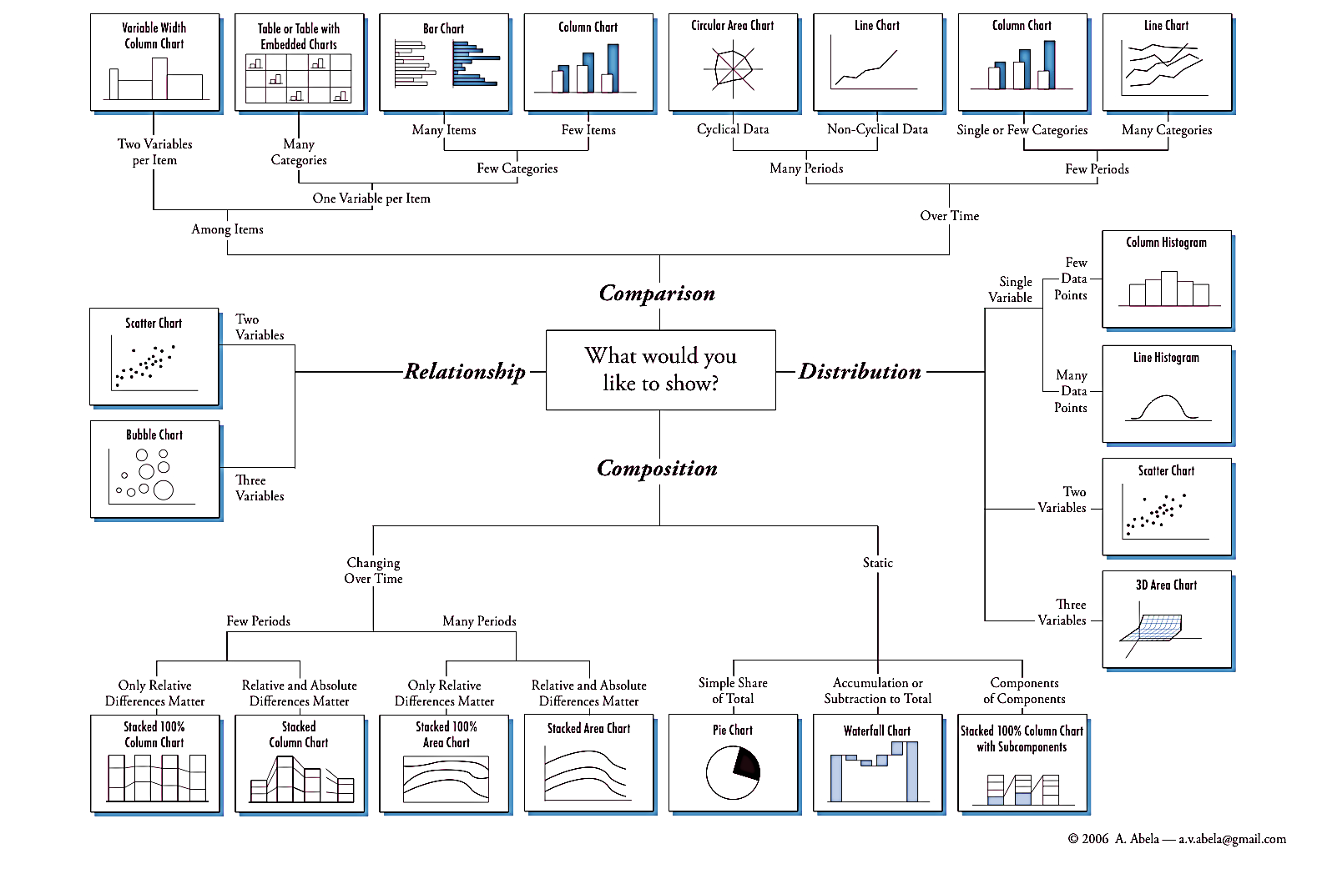
Abela’s Chart Hierarchy

Slide 16

Ggplot2 (in_class_examples.Rmd)
Let’s play a bit

Slide 17
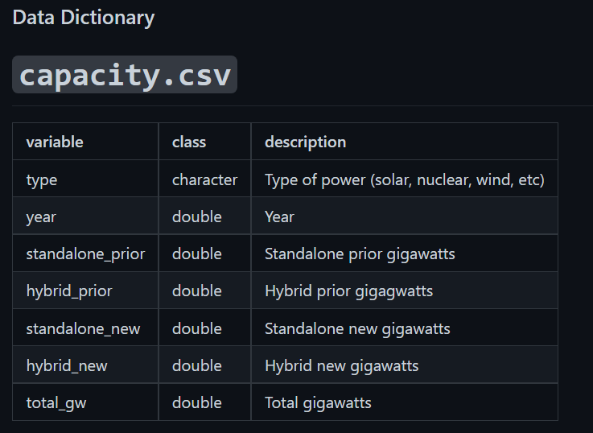
Essential Syntax
Component | Details
Data | capacity %>% filter(type == “Solar”)
Geom | geom_line()
Aesthetic | x = year y = total_gw
All three lines of code output the same plot:
g <- ggplot( data=capacity %>% filter(type == “Solar”), aes(x=year,y=total_gw) ) + geom_line()
g <- ggplot( data=capacity %>% filter(type == “Solar”) ) + geom_line( aes(x=year,y=total_gw) )
g <- ggplot() + geom_line( data=capacity %>% filter(type == “Solar”), aes(x=year,y=total_gw) )

Slide 18
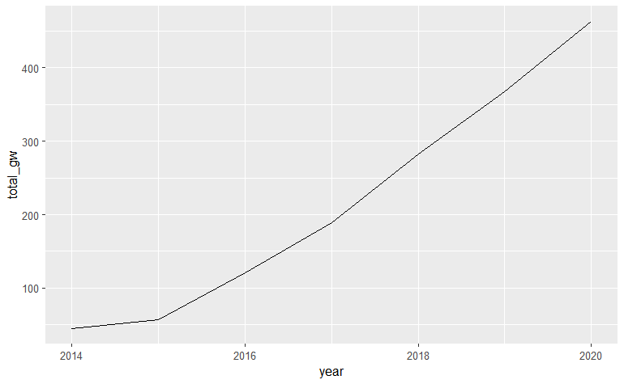
Essential Syntax

Slide 19
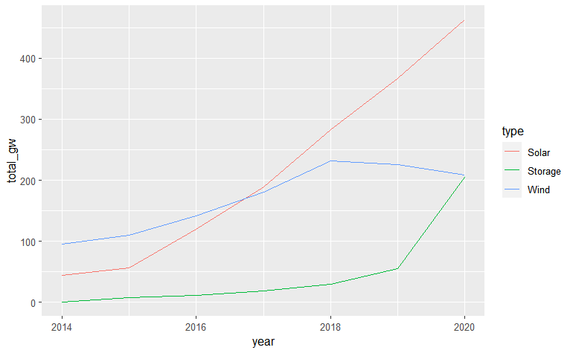
Plotting More Than One Series
Component | Details
Data | capacity %>% filter( type == “Solar” ) | capacity %>% filter( type == “Wind” ) | capacity %>% filter( type == “Storage” )
Geom | geom_line() | geom_line() | geom_line()
Aesthetic | x = year y = total_gw | x = year y = total_gw | x = year y = total_gw
Component | Details
Data | capacity %>% filter(type %in% c(“Solar”, “Wind”, “Storage”)
Geom | geom_line()
Aesthetic | x = year y = total_gw color = type

Slide 20
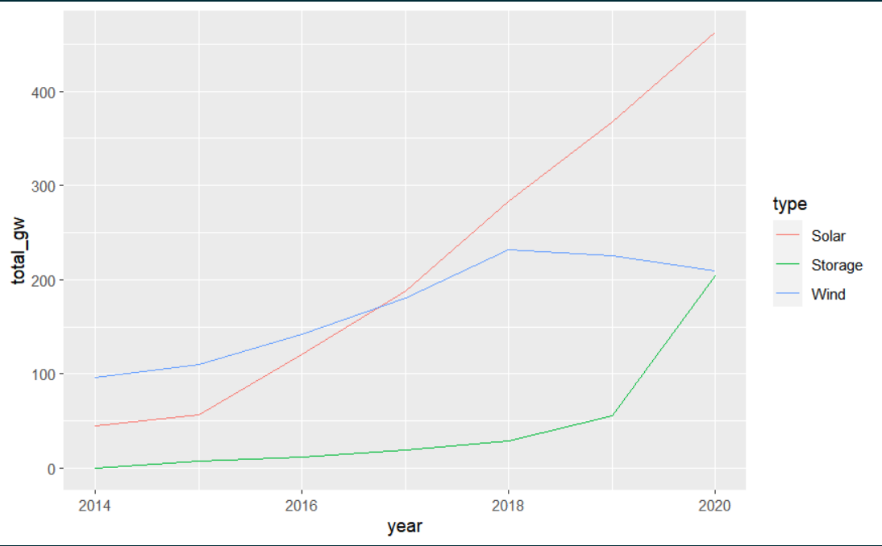
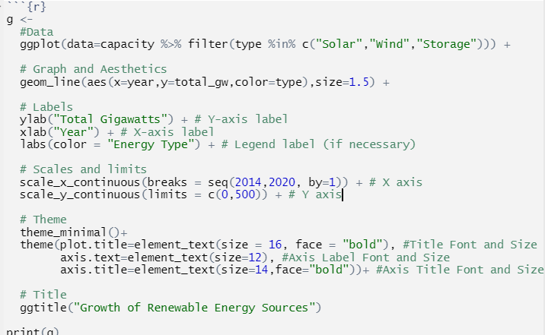
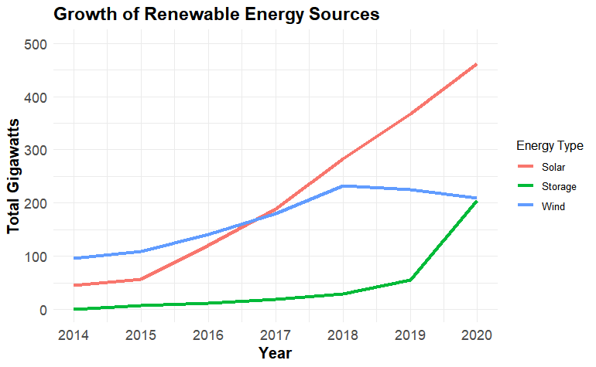
Basics for Prettier Plots

Slide 21
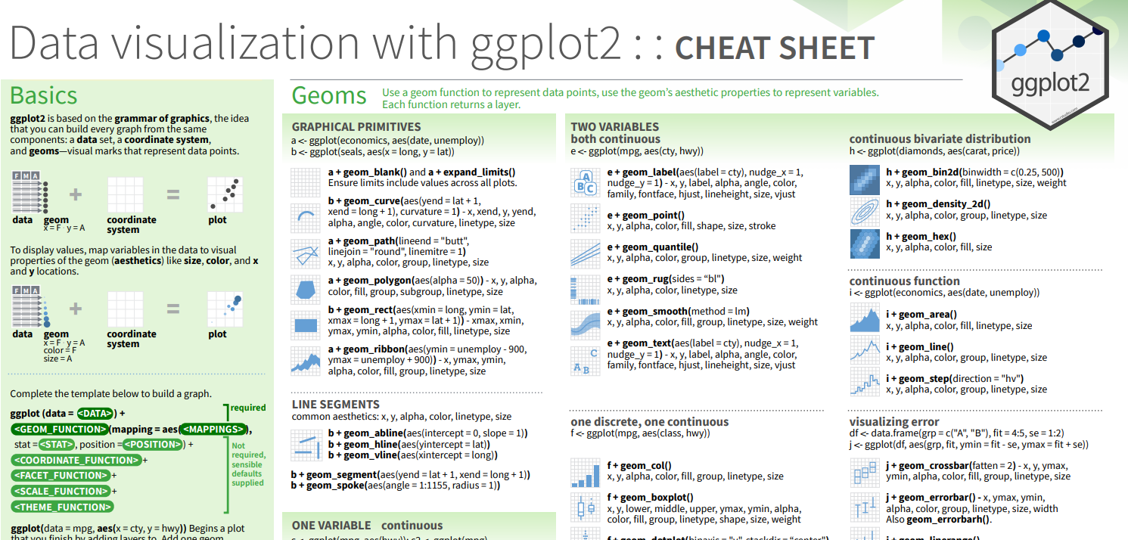
ggplot Quick Guide
Download here: https://posit.co/wp-content/uploads/2022/10/data-visualization-1.pdf

Slide 22
Sharing Plots with ggsave or plotly
If it’s good, let’s share it!

Slide 23
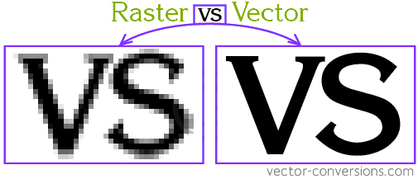
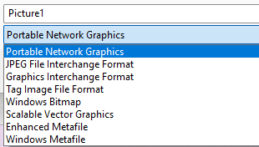
Basic save using ggsave
Formats
.eps - vector
.pdf - vector
.svg - vector
.wmf - vector
.png
.jpg
.bmp
.tiff
Sizes
width/height with
units OR
resolution
=> Saving files is one of the easier ways to control the scale and shape of graphics when making a final production graphic.

Slide 24
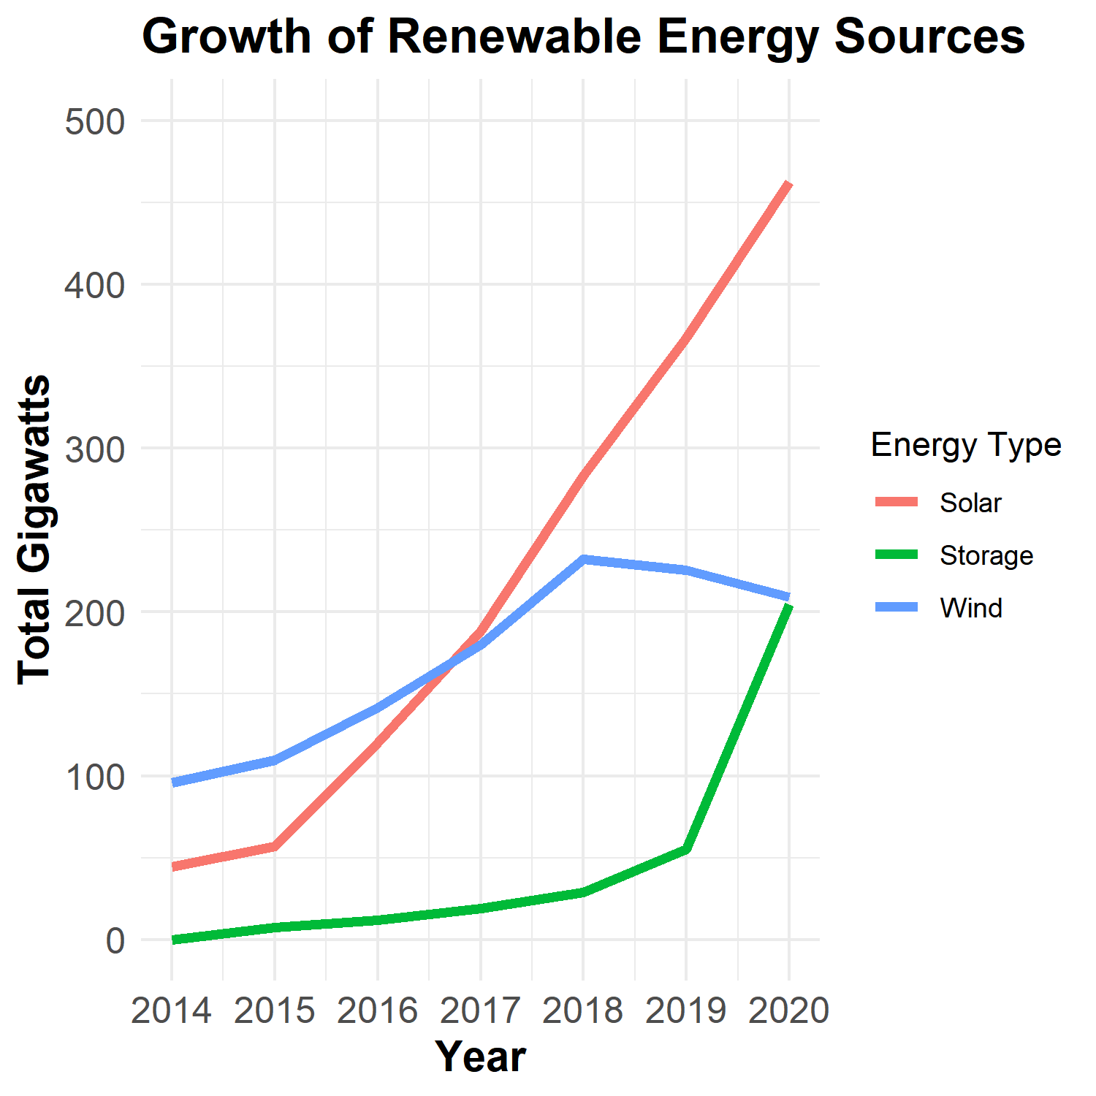
Example
For the last plot:
ggsave( "output/renewable_energy_growth.png", width=1500, height=1500, units = "px")
For a saved plot (named here “g”)
ggsave("output/renewable_energy_growth.png",plot = g, width=1500, height=1500, units = "px")

Slide 25
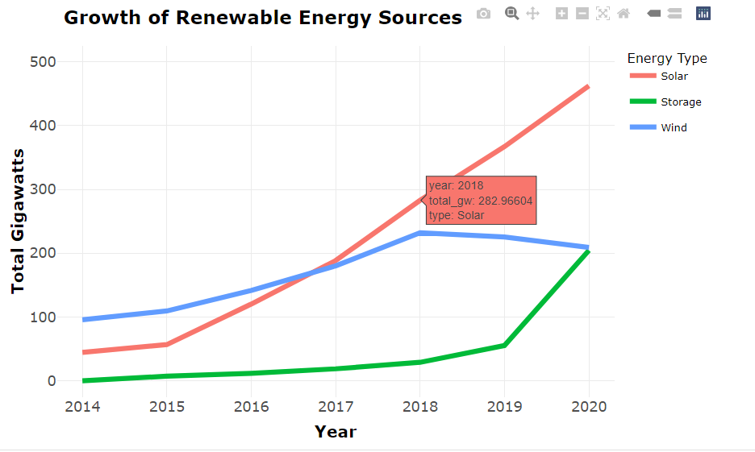
Interactive plot presentation with Rmarkdown and plotly
Plotly (https://plotly.com/ggplot2/)
Plotly enables user-interactive plots through HTML embedding.
Library
install.packages(“plotly”)
Use
Load plotly library
Create your ggplot graphic and save to a variable (say “g”)
Pass your variable into ggplotly(g) and an html object is returned

Slide 26

Live Programming Session (week4-Exploration.Rmd)
Let’s do some R and Tableau

Slide 27
Appendix - Basic Statistical Concepts
XXXXXXXXXXXXXXXX

Slide 28
Basic Statistical Concepts
Understanding Univariate Distributions
What is a distribution?
Measures of tendency and variability
Confidence intervals
Understanding Relationship Between Variables
Correlation
Test of mean
Regression analysis
Trends

Slide 29
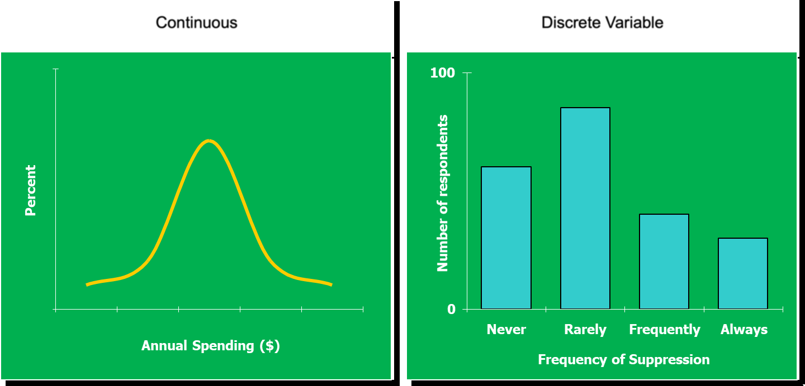
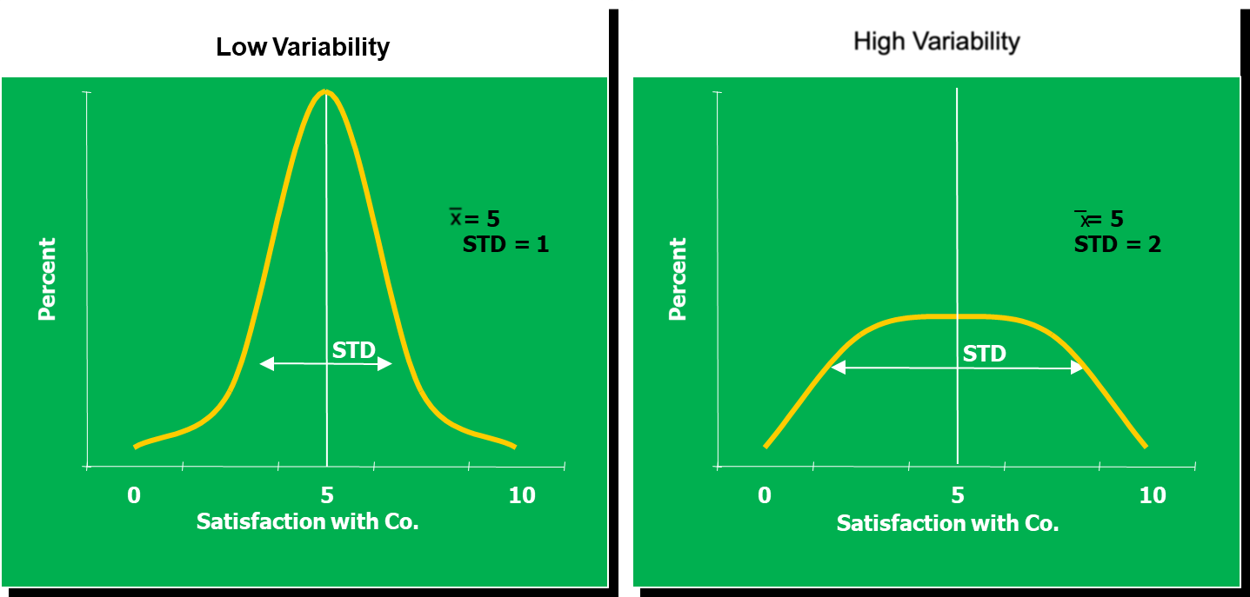
I. Understanding Univariate Distributions
^{What is a distribution?}
Measures of Tendency/Variability
Mean
Variance and standard deviation
Frequency concentration
What other statistical measures to look at in a distribution? [summary (data)]
Median
Mode
Minimum and Maximum value (for outlier detection)

Slide 30
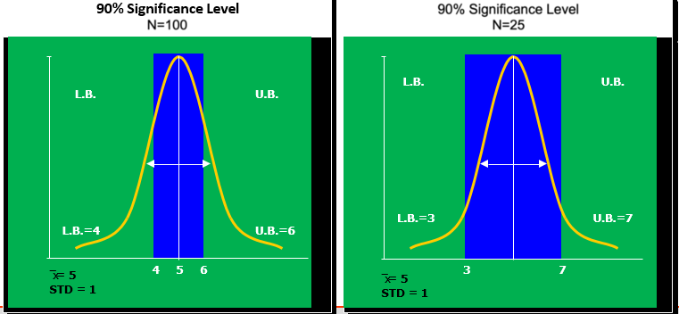
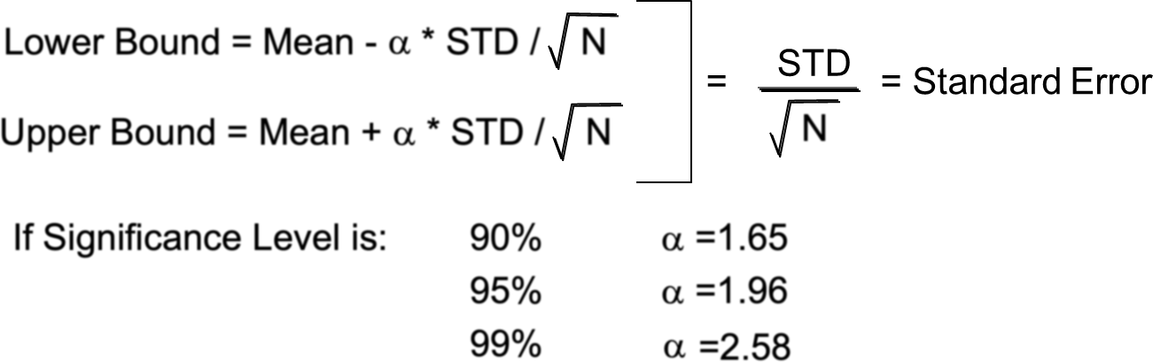
I. Understanding Univariate Distributions - Continued
Confidence Intervals (CI)
A mean is just an estimate from a sample
It can vary from sample to sample
To take into account this variability we can include a band of confidence around the mean
We determine the width of the band from the probability that the estimate is correct, i.e. the significance level
Example: 0.9 significance level means that with 0.9 probability, the mean is correct
Everything else equal if the variability is higher the confidence interval is wider
As N increases we are more confident that our
estimate is correct
As N increases the width of the confidence level decreases
CI calculation

Slide 31
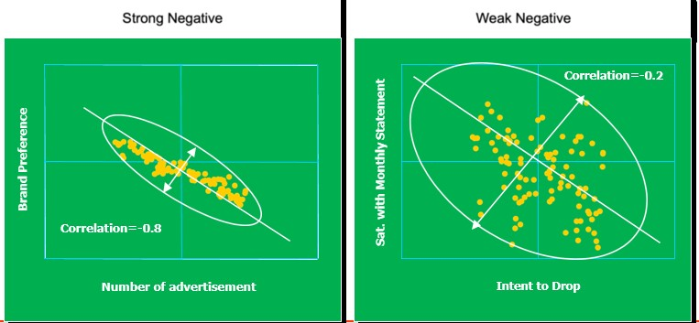
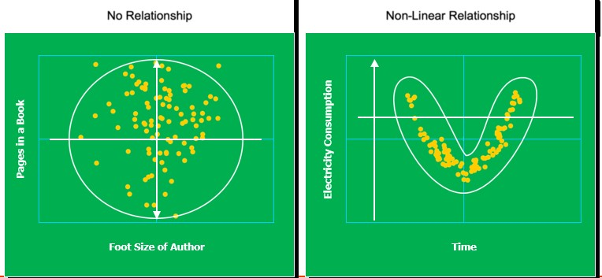
II. Understanding Relationship between Variables
Correlation:
The degree to which a linear relationship exist between two variables
It has values ranging from -1 to +1 indicating negative or positive correlation and strength of the correlation
Correlation coefficient are used to measure the strength between two variables
Pearson correlation is the one most commonly used in statistics. This measures the strength and
direction of a linear relationship between two variables

Slide 32
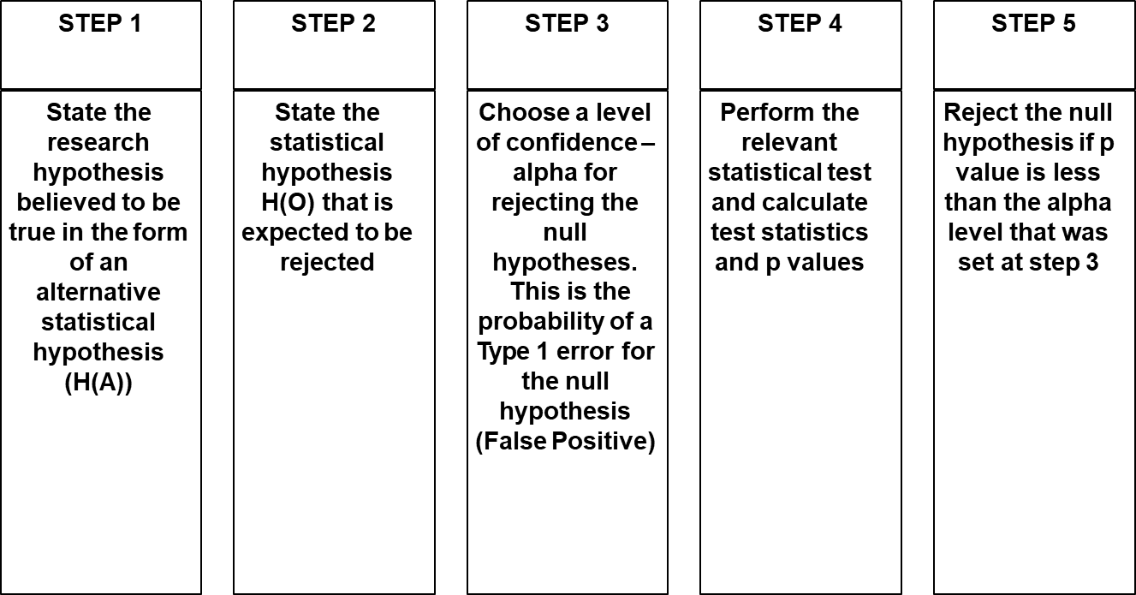
II. Understanding Relationship between Variables Cont’d
Test of Mean
Compare two means and test if they are significantly different from a STATISTICAL point of view
Need to define a significance level for the test – 80%, 90%, 95%, 99% or something else?
Leverage Hypothesis Testing Development and Statistical Testing Process

Slide 33
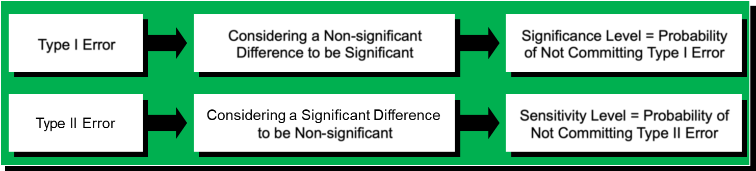
II. Understanding Relationship between Variables Cont’d
Test of Mean Cont’d
The interpretation of significance level in a test of mean is derived from the significance level of confidence interval around each individual mean
As for confidence intervals N, standard deviation and significance level can change the outcome of the test:
If N increases, a significant difference is more likely
If the standard deviation increases, a significant difference is less likely
If significance level increases, a significant difference is less likely
Two Types of Error
Type 1 Error is True Positive Rate
Type II Error is False Negative Rate

Slide 34
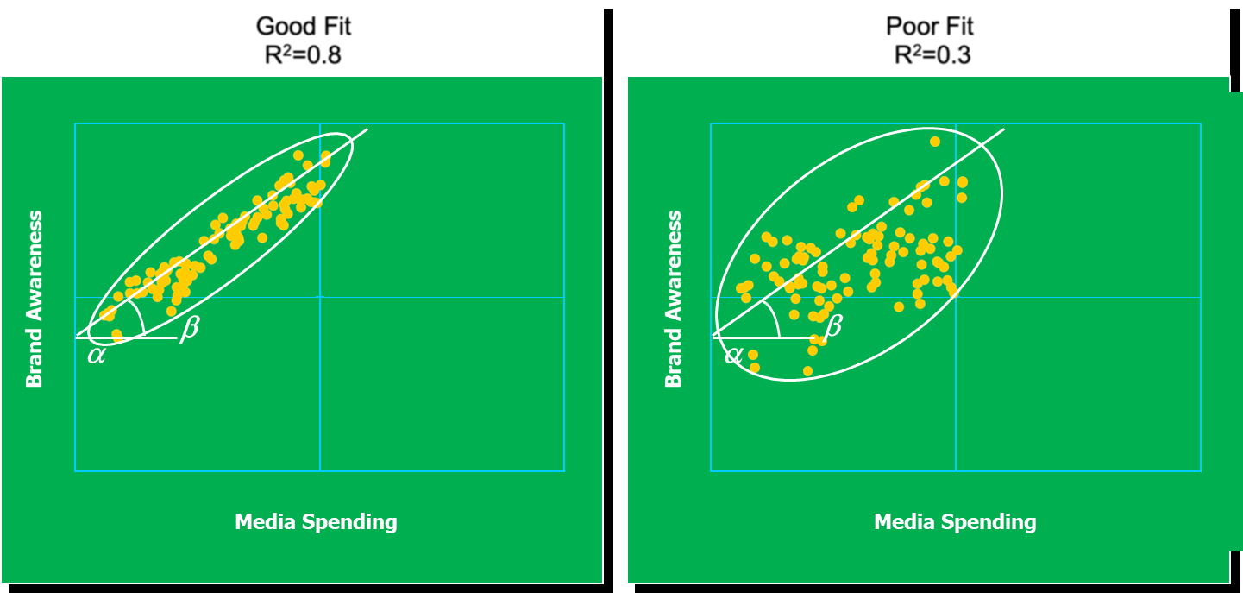
II. Understanding Relationship between Variables Cont’d
Regression Analysis (Univariate Regression)
R2: Measure of goodness of fit whose range is 0 to 1
0 = no linear relationship
1= perfect linear relationship

Slide 35
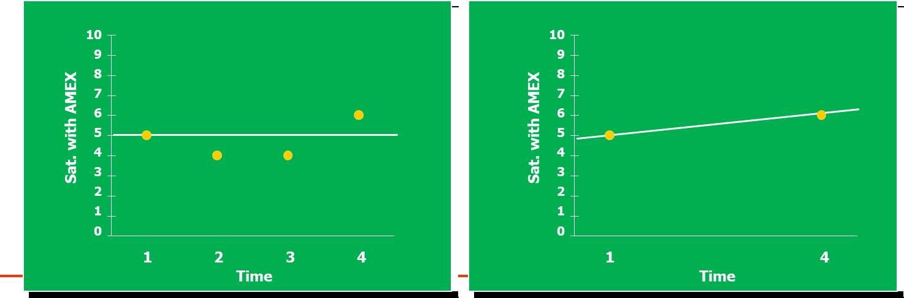
II. Understanding Relationship between Variables Cont’d
Trend:
Time series analysis
The independent variable is time: we track overtime the evolution of a variable (e.g., Customer
Satisfaction). y = α + βt + error
Over 2 periods is the same as a test of the mean for independent samples, but we will look at longer period of time to understand changes of Customer Satisfaction overtime

